Slide 1

Exam DP-201: Designing a Microsoft Azure Data Solution Crash Course
Tim Warner

Slide 2


Tim Warner
Based in Nashville, TN, US
Central time zone
MCT, MVP
Twitter: @TechTrainerTim
Badge: timw.info/dpcert

Slide 3
Day 1 of 2 Agenda
Introduction
Identity and Security Design
Storage Data Design
Monitoring Design

Slide 4
Day 2 of 2 Agenda
Content catch-up
Business Continuity Design
Infrastructure Design
Exam AZ-304 strategy

Slide 5
Course Materials
timw.info/dp201

Slide 6
A Different Kind of Training
We'll learn by doing – at least 80 percent demo
Visual, case study approach
10-minute break at midpoint
I’m here to answer your questions – take advantage of this!
Use the Q&A panel

Slide 7

Session Recordings

Slide 8
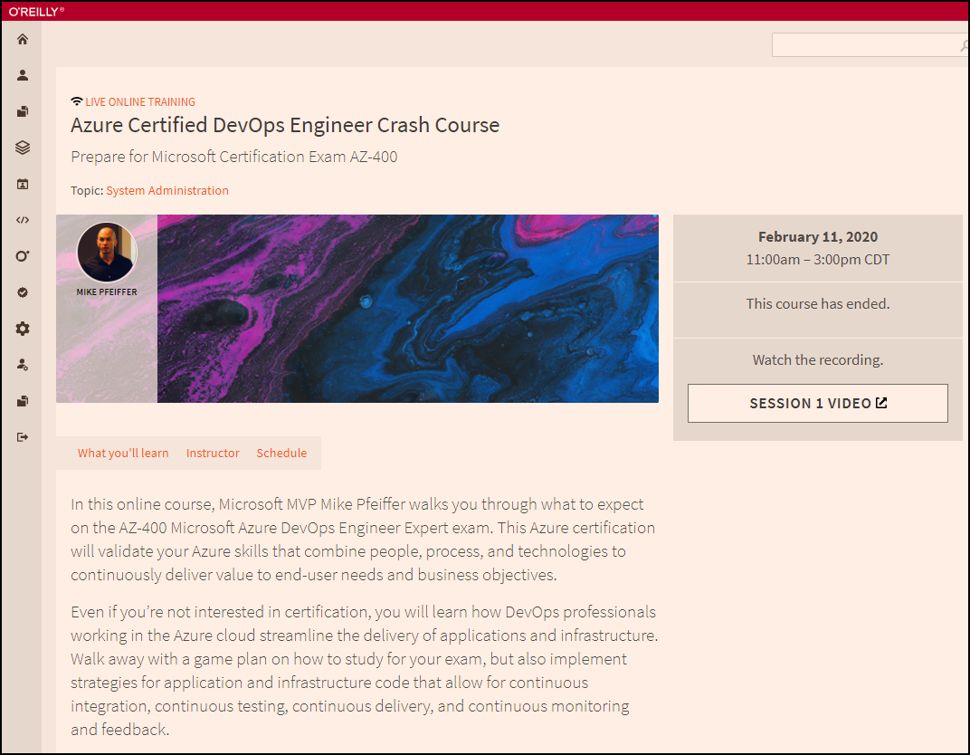
Session Recordings

Slide 9

Session Recordings

Slide 10

DP-201 Changes in 2021
Until June 30, 2021
DP-200
DP-201

Slide 11

DP-201 Changes in 2021
After June 30, 2021
DP-203
DP-203
DP-203
Data Engineering on Microsoft Azure
Data Engineering on Microsoft Azure

Slide 12
What is an Azure Data Engineer?
Design and implement the management, monitoring, security, and privacy of data using the full stack of data services
“Builds and tunes data pipelines”
“Implements, monitors, and optimizes data platforms”
“Has solid knowledge of SQL, Python, or Scala”
The Azure Data Scientist consumes the data the Engineer provides

Slide 13
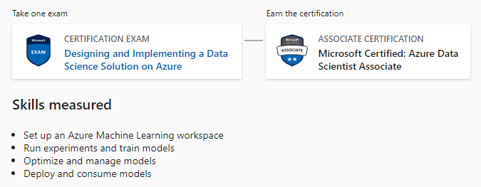
Azure Data Scientist Associate
DP-100

Slide 14
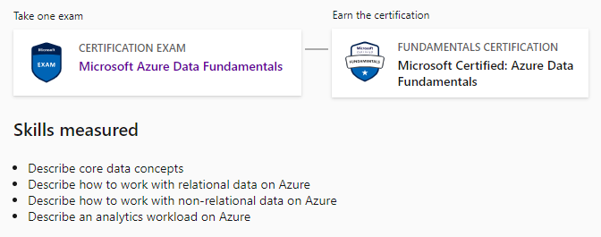
Azure Data Fundamentals
DP-900

Slide 15

Case Study

Slide 16

Active Screen

Slide 17
Tim's Certification Study Pyramid
Interdependence
Content knowledge
Practical application
Test-taking skills

Slide 18
Thank you!
Course materials: timw.info/dp201
Twitter: @TechTrainerTim
Work: timw.info/ps
Web: TechTrainerTim.com

Slide 19
Storage Account Replication
1
3
3
2
LRS
ZRS

Slide 20
Storage Account Replication
3
3
GRS/RA-GRS

Slide 21
Storage Account Replication
1
3
1
3
2
2
GZRS – RA/GZRS

Slide 22

Always Encrypted

Slide 23
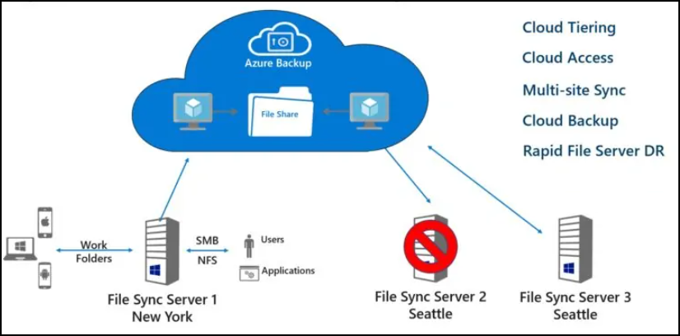
Azure File Sync

Slide 24
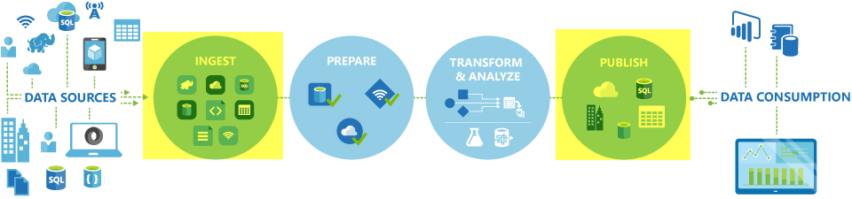
Azure Data Factory

Slide 25

Azure Monitor

Slide 26

Data Pipelines

Slide 27
Azure Diagnostics

Slide 28

Log Analytics

Slide 29
Exam DP-201 Item Types

Slide 30

Multiple Choice

Slide 31
Repeated Scenario
You need to move an Azure VM to another hardware host.
Solution: You redeploy the VM.
Does this solution meet the goal?
Yes
No

Slide 32

Select and Place

Slide 33

Build List and Reorder

Slide 34
Active Screen/Fill in the Blank

Slide 35
Case Study

Slide 36






Performance-Based Lab

Slide 37
Microsoft Online Testing

Slide 38
Microsoft Online Testing Process
timw.info/online

Slide 39
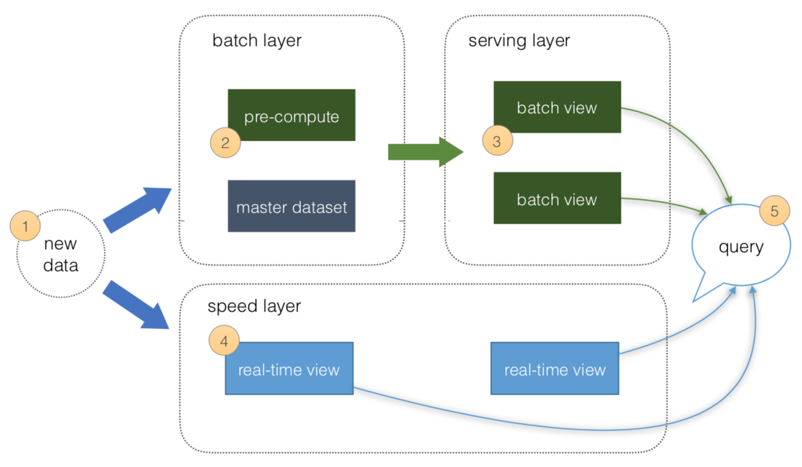
Lambda architectures from a real time mode perspective
Speed Layer:
The Speed layer processes data streams in real or near real time. This works well when the aim is to minimize the latency of the data ingestion to analysis:
New data ingested from sources
4. Real time views of the data created
Serving Layer:
The serving layer is optional in the real-time architecture and acts as the storage output of either the Batch or Speed layer that is used by client applications to access the results of the data-sets

Slide 40
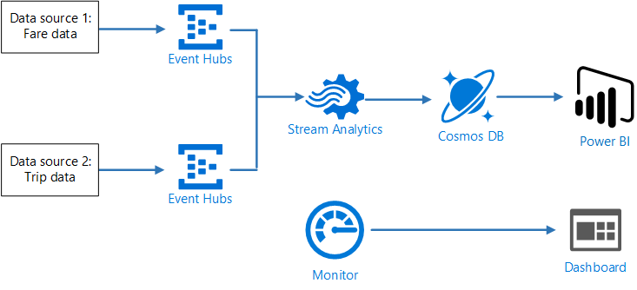
Architect a stream processing pipeline with Azure Stream Analytics

Slide 41
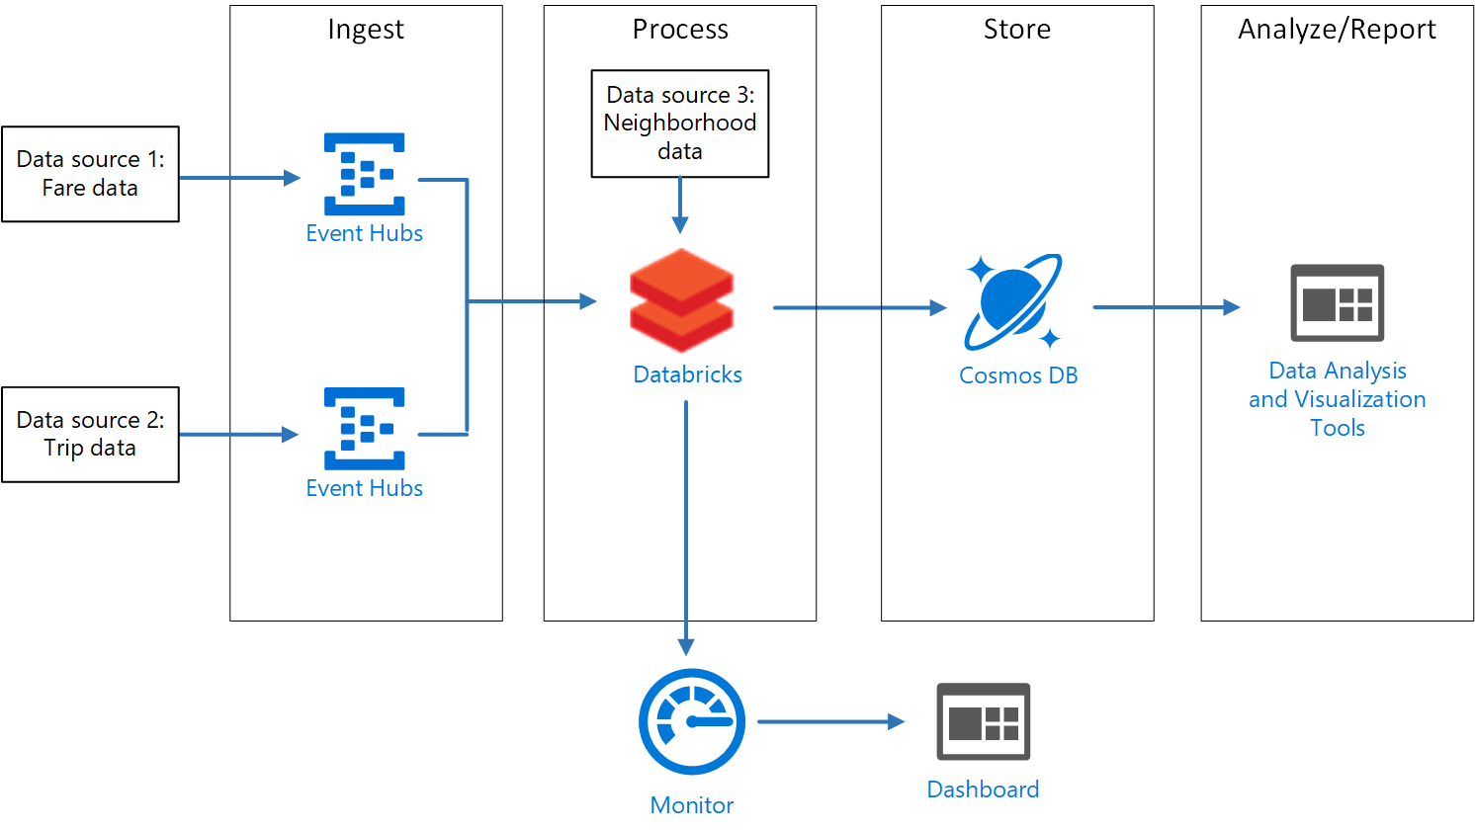
Design a stream processing pipeline with Azure Databricks

Slide 42
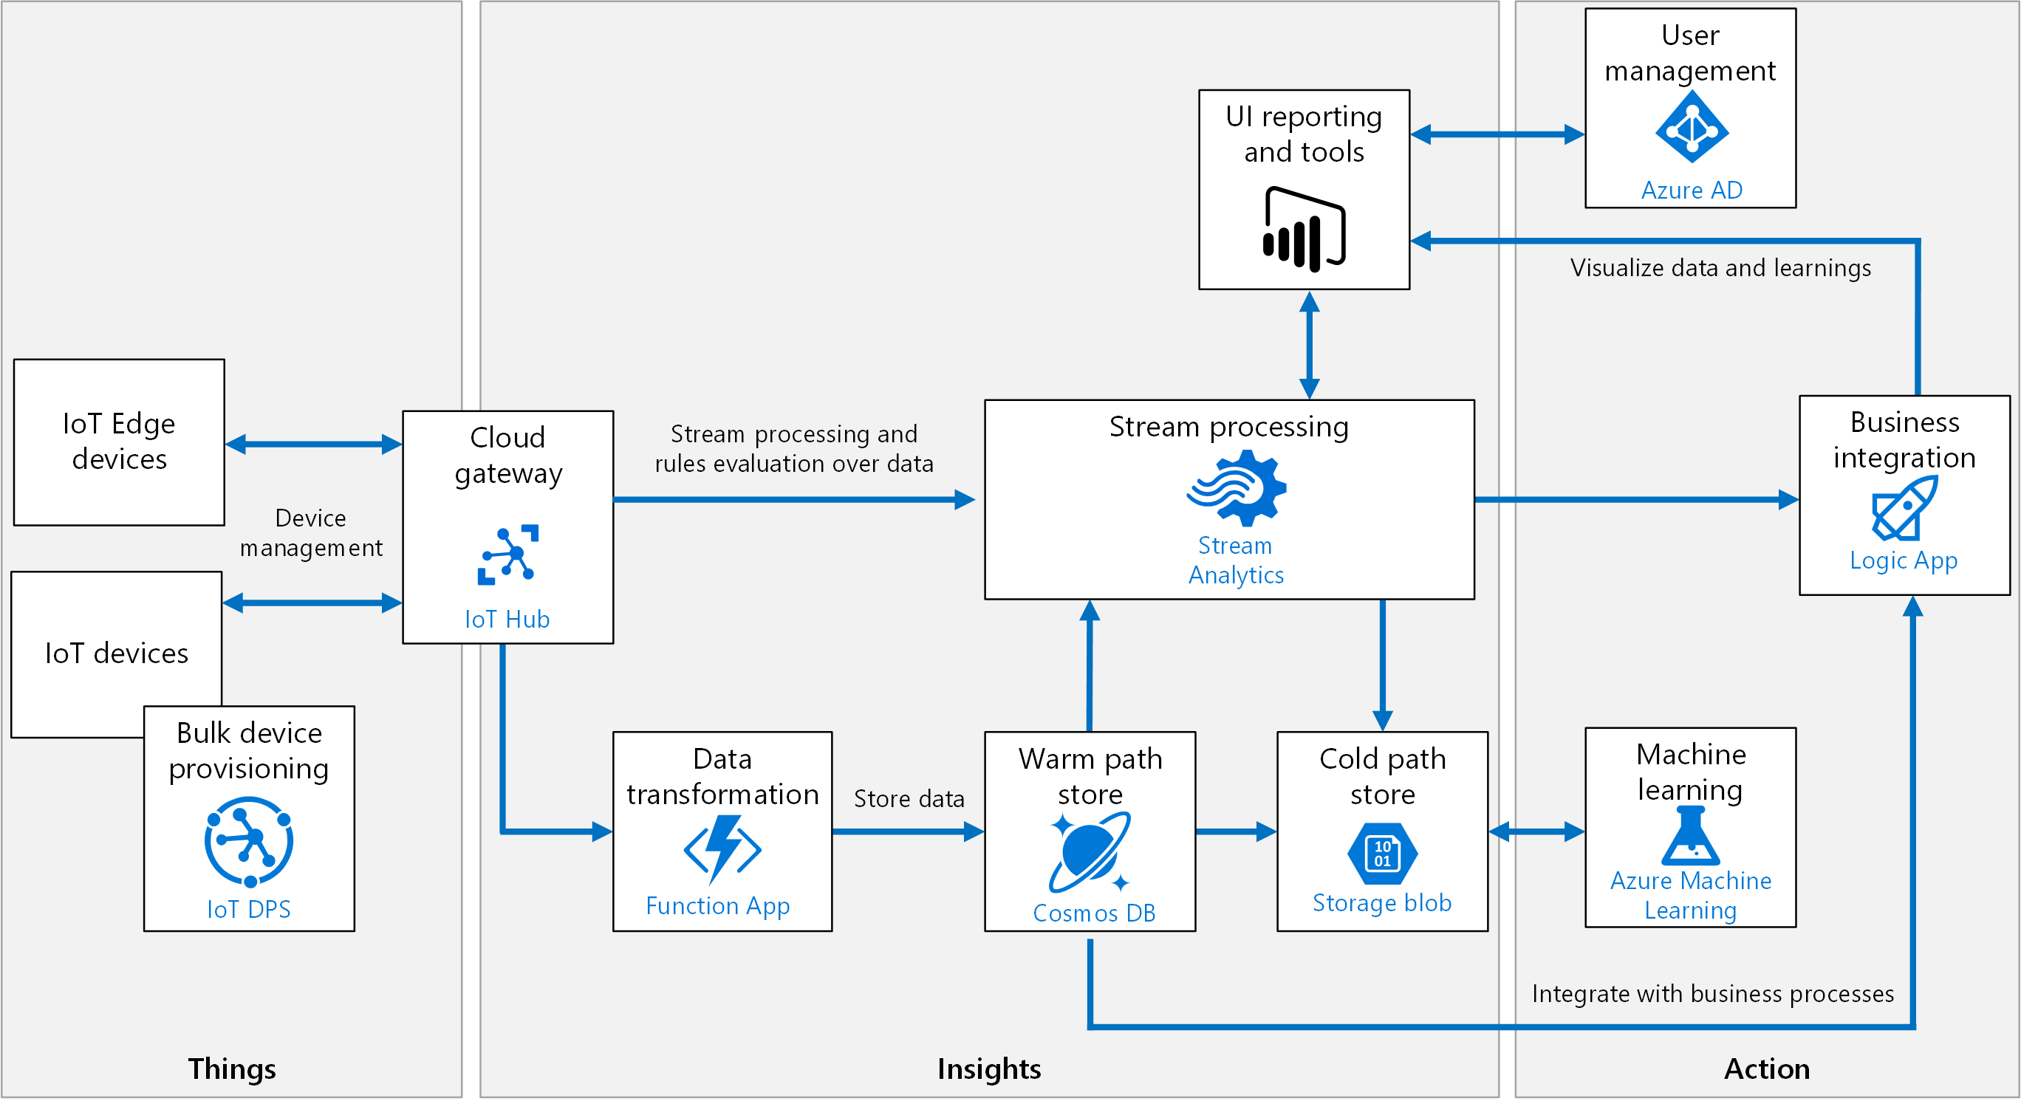
Create an Azure IoT reference architecture

Slide 43
Lambda architectures from a batch mode perspective
Batch Layer:
The Batch layer is used to pre-compute results on large volumes of data using a distributed data system:
New data ingested from sources
Data is precomputed
Serving Layer:
The serving layer acts as the storage output of either the Batch or Speed layer that is used by client applications to access the results of the data-sets:
Batch views can be used as precomputed views

Slide 44
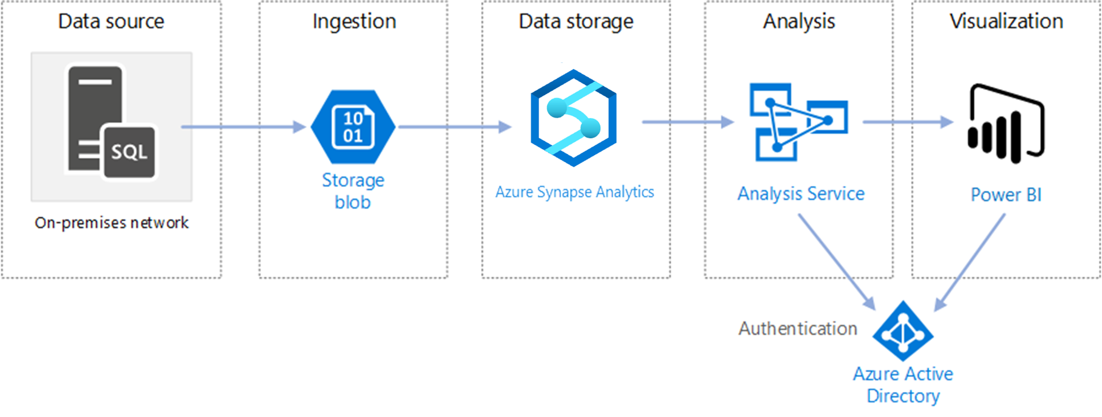
Design an enterprise business intelligence architecture

Slide 45
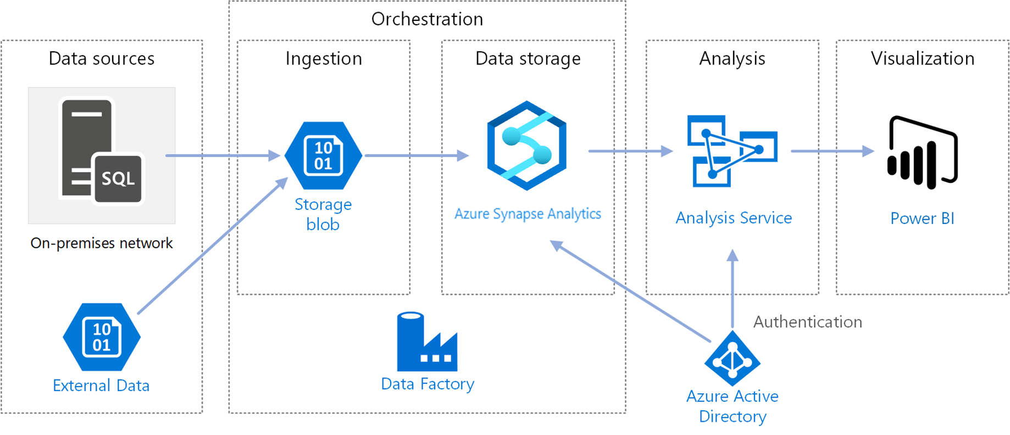
Automate an enterprise business intelligence architecture

Slide 46
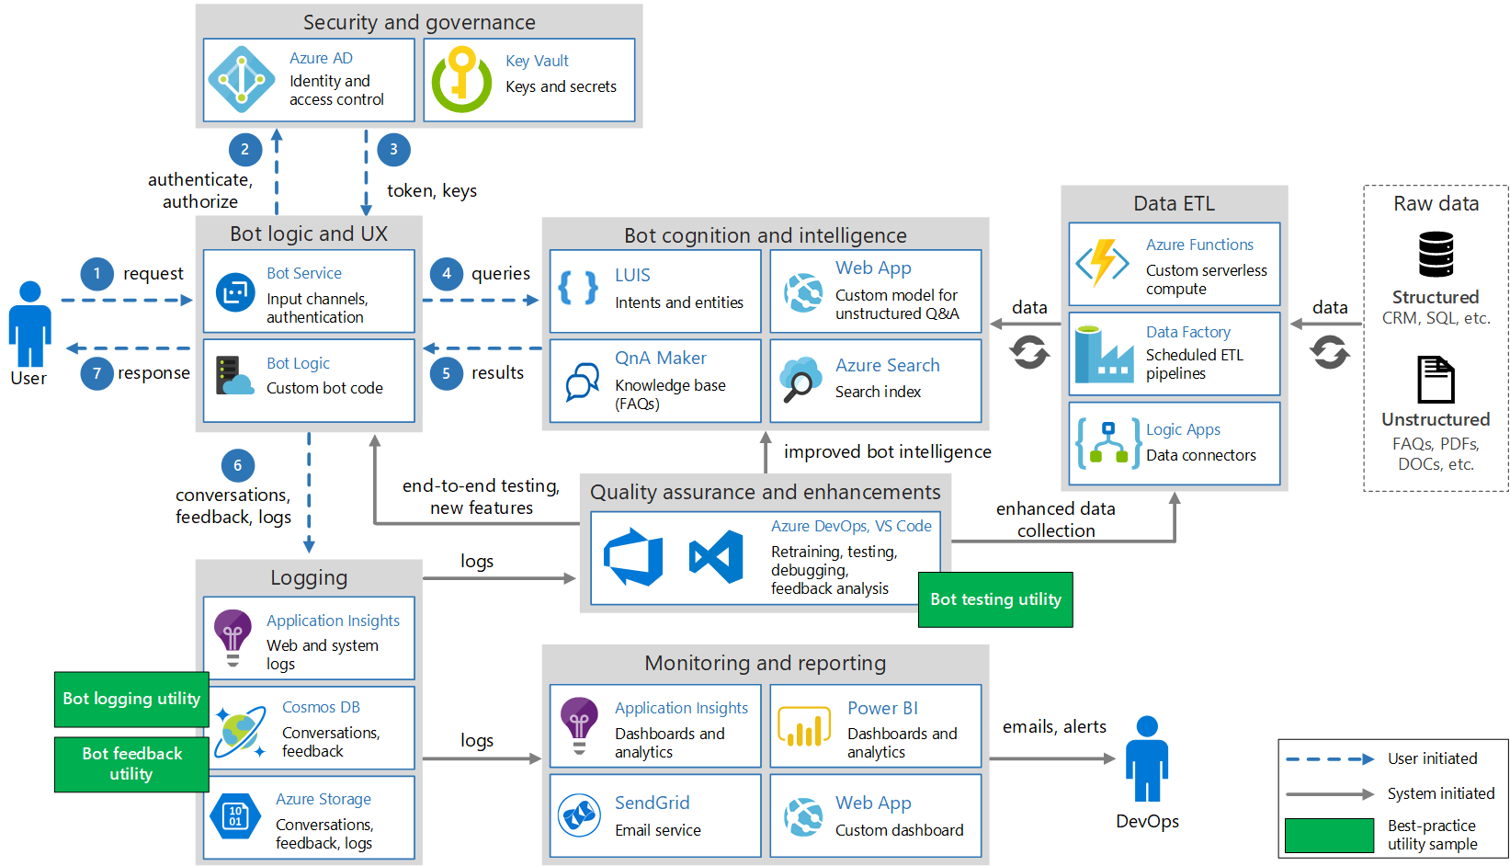
Architect an enterprise conversational bot

Slide 47
Design for security
Physical security
Identify & access
Perimeter
Network
Compute
Application
Data

Slide 48
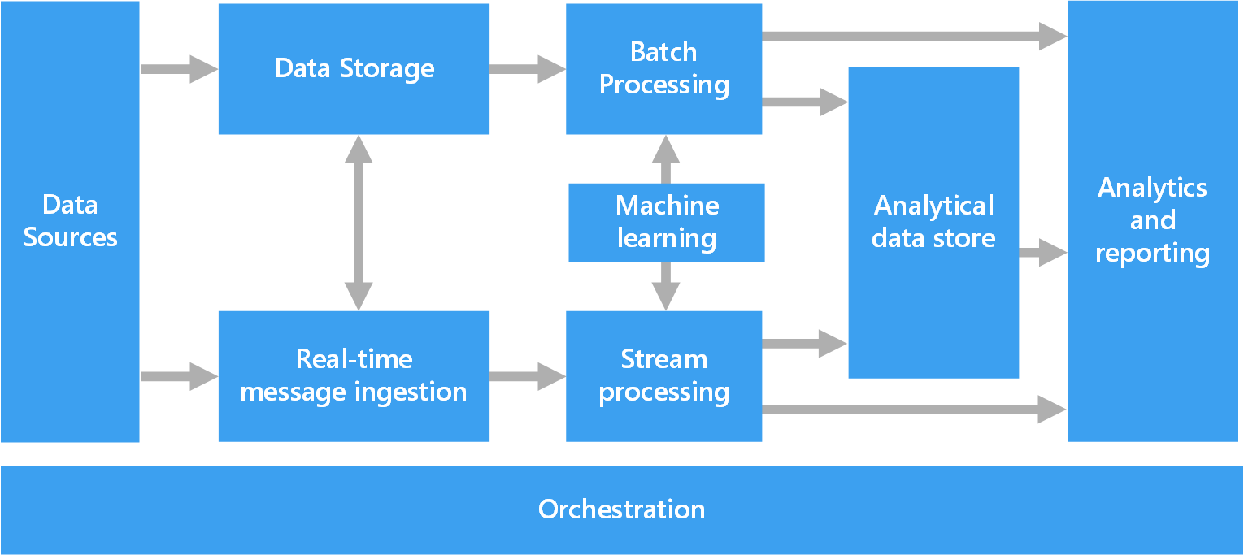
Big Data Architecture

Slide 49
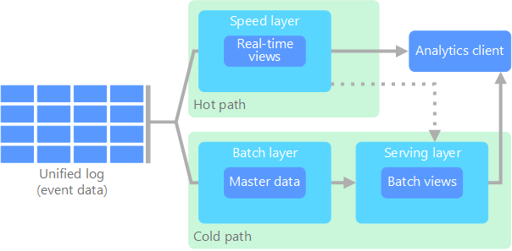
Lambda Architecture

Slide 50
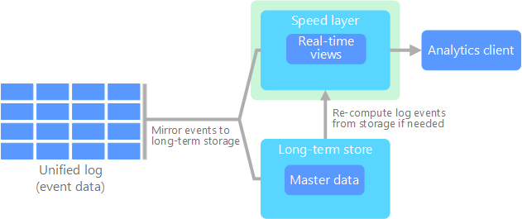
Kappa Architecture

Slide 51
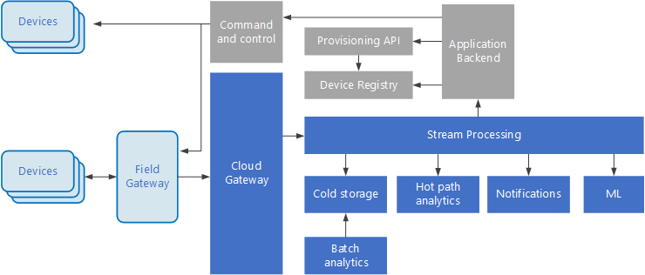
Internet of Things (IoT)

Slide 52
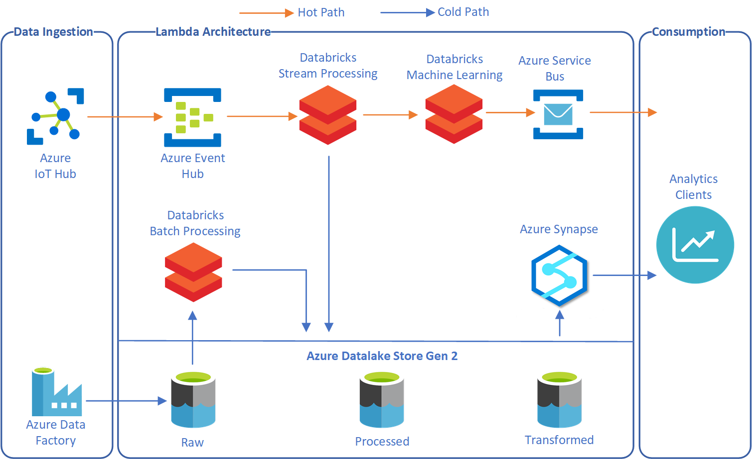
Lambda Architecture with Databricks

Slide 53
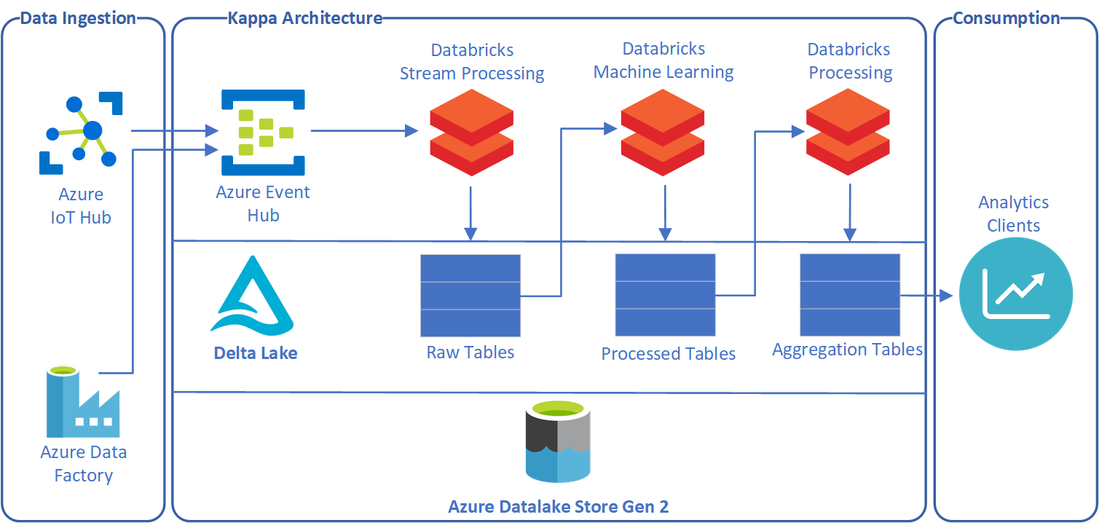
Kappa Architecture with Databricks

Slide 54
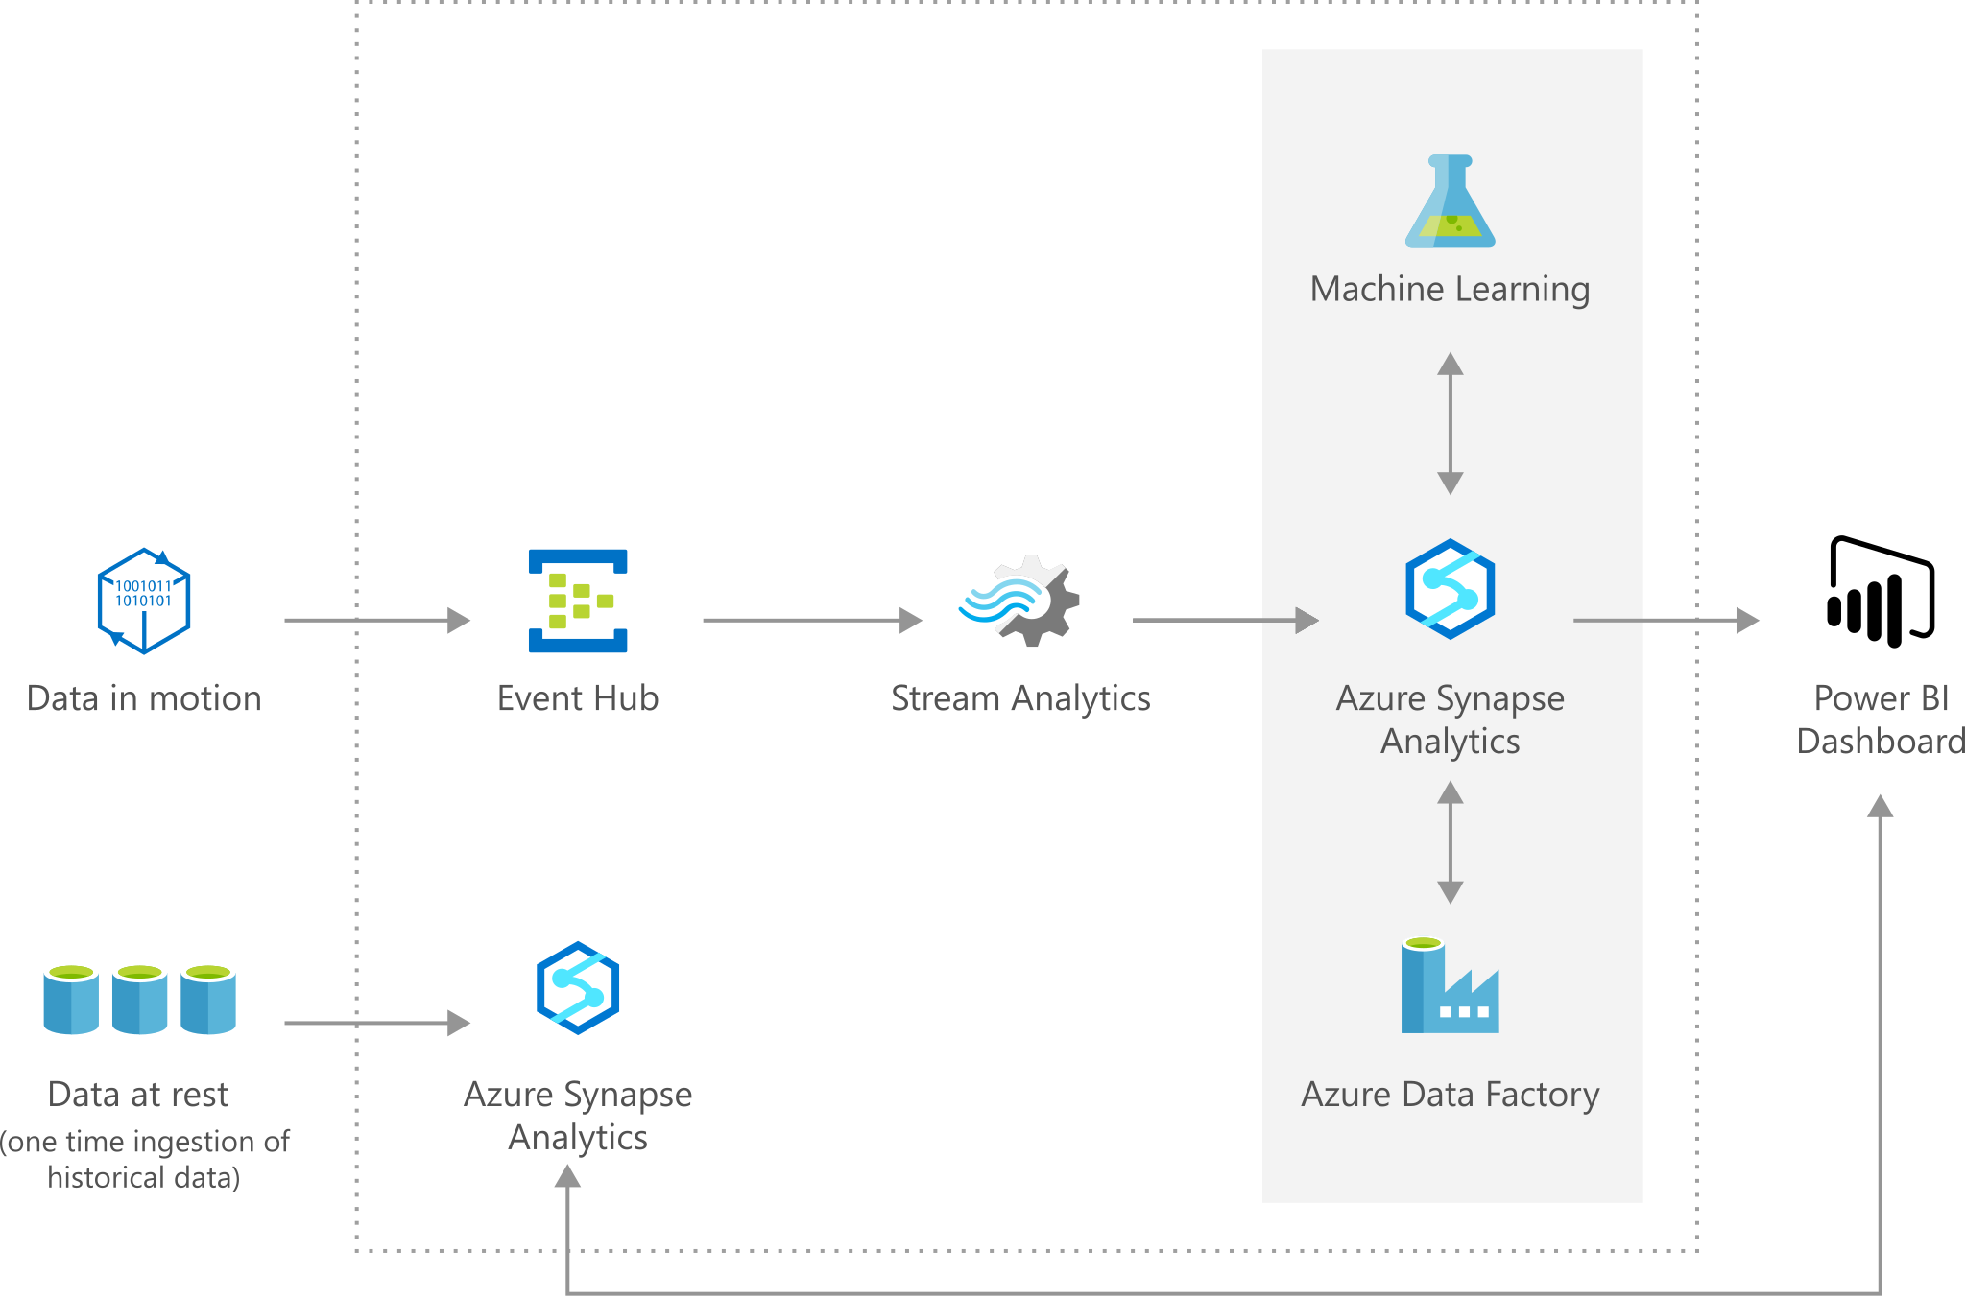
Oil and Gas Forecasting

